Slide 1
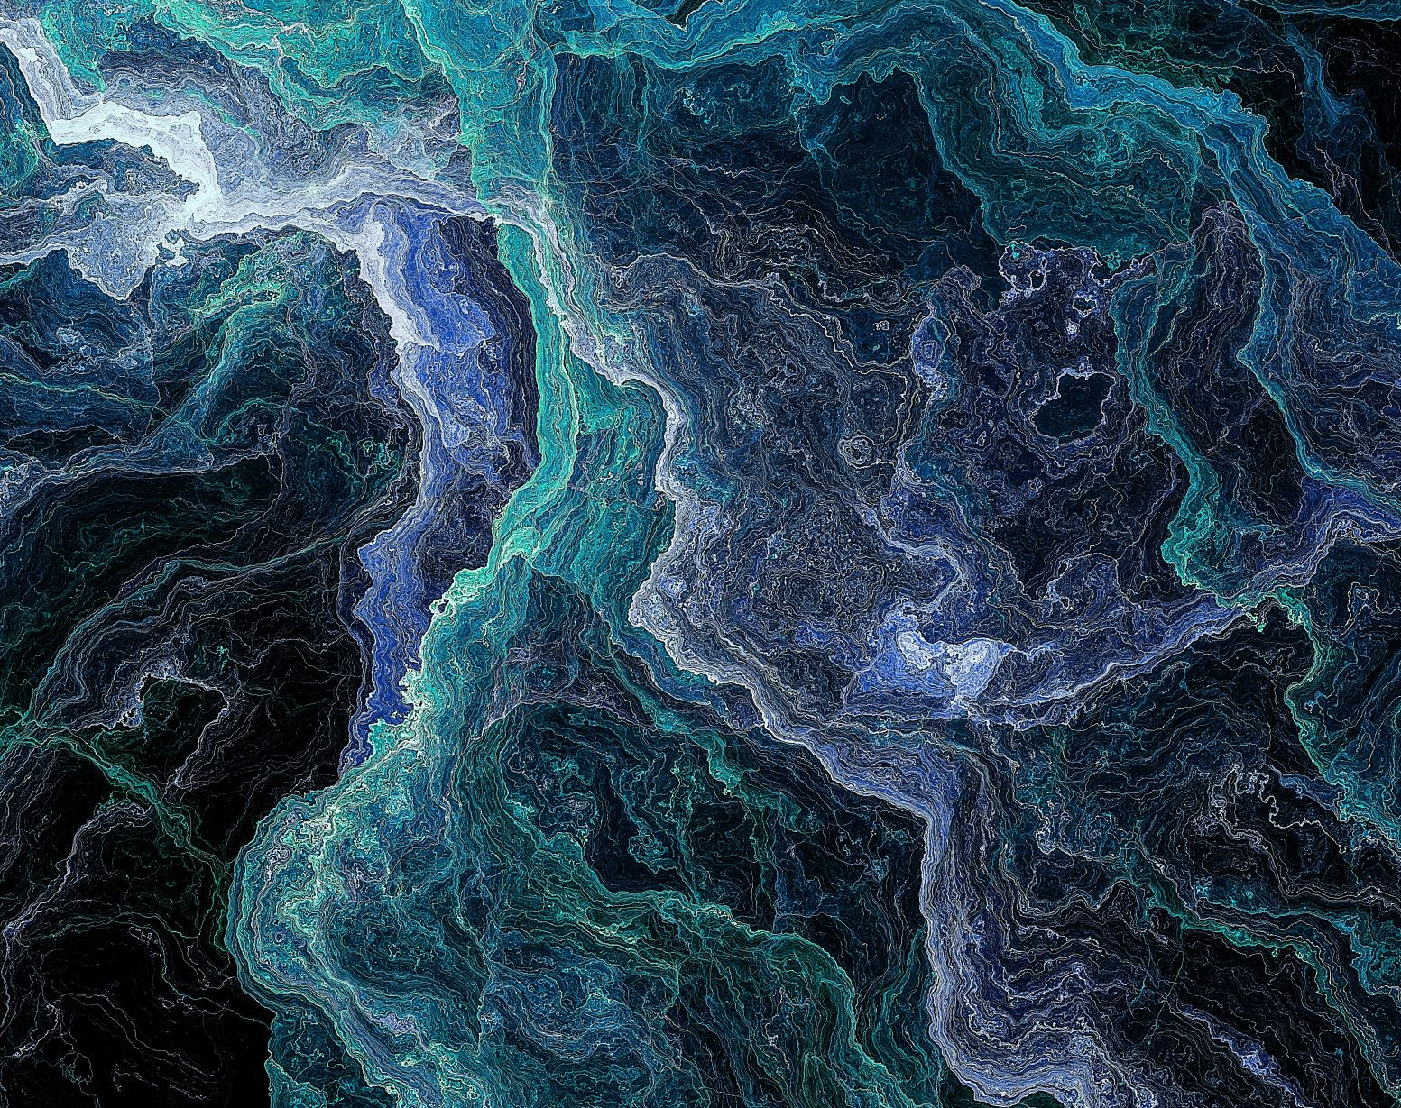
Multi-Class Image Classification With Paintings
Using Keras to Predict Painting’s Type

Slide 2
Overview
Objective
Fetching Data
The Convolutional Neural Network Model
Results
Obstacles

Slide 3

Objective
The aim was to use ML techniques to develop a model that could recognize the type of painting it was injected with.
Specifically, the types my model should’ve been able to differentiate were 6.

Slide 4
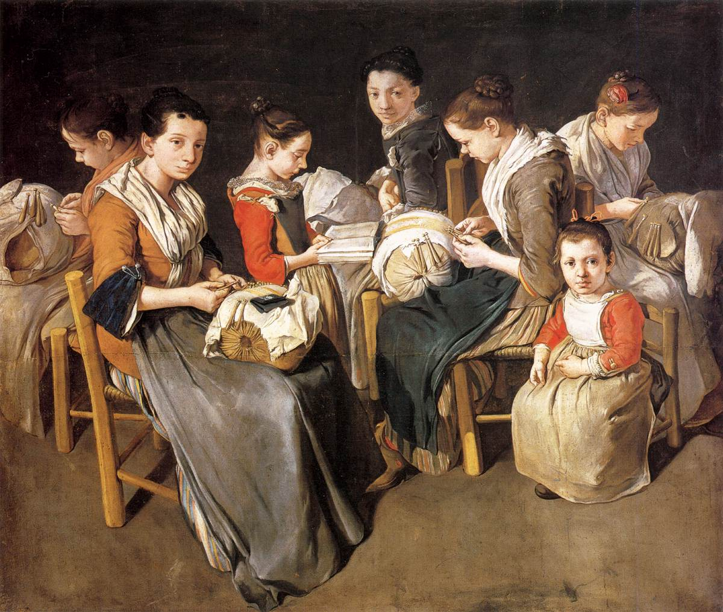
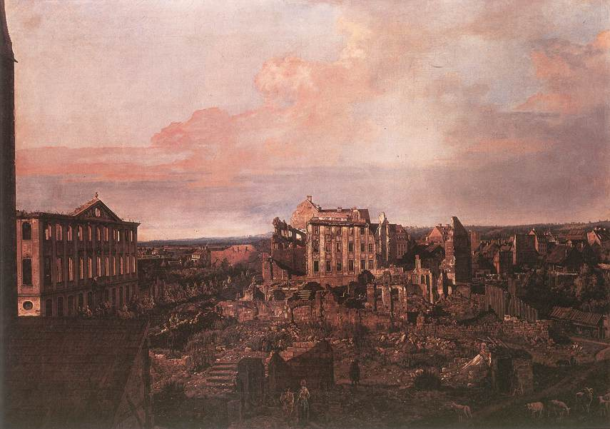
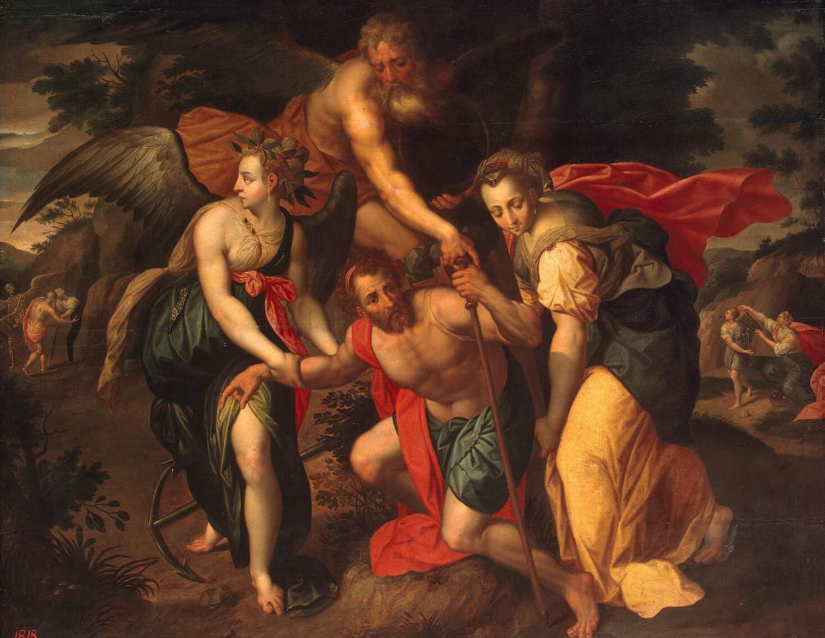
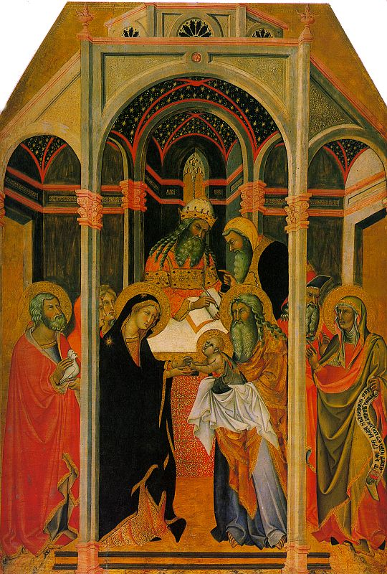
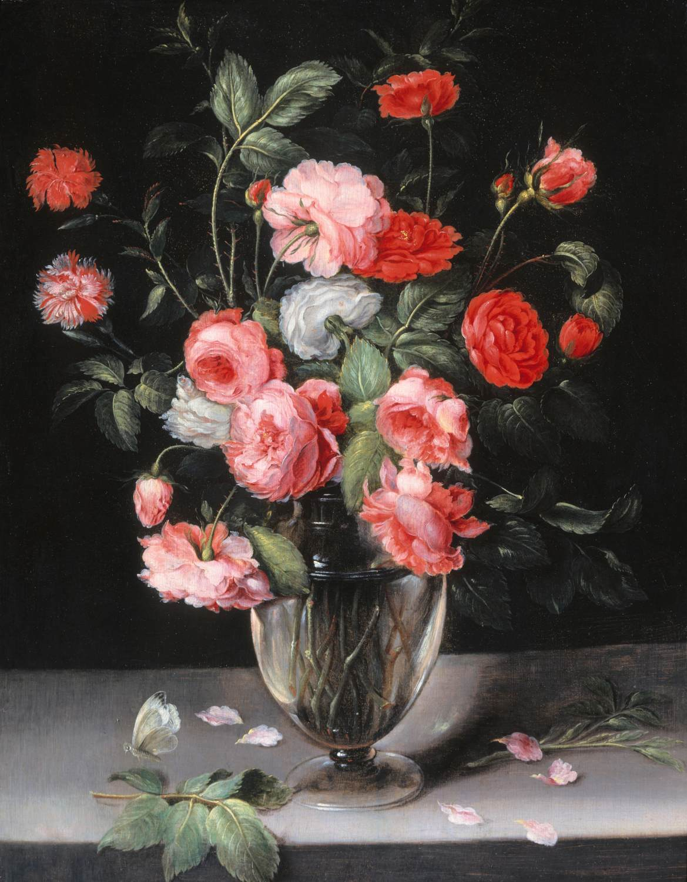
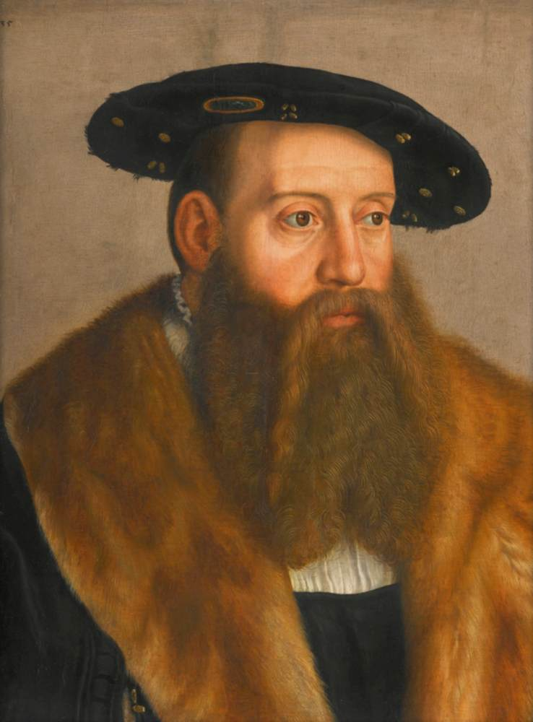
Genre
Landscape
Mythological
Religious
Still-life
Portrait

Slide 5
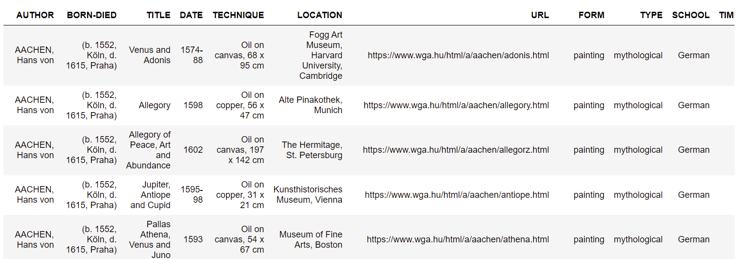
Fetching Data
The images were obtained by web-scraping the Web Gallery of Art website., ending up with a database of around 31,000 pictures!

Slide 6
Convolutional Neural Network (CNN)
CNNs are one of the most powerful techniques for Image Recognition problems, and Keras revealed itself as a very efficient library that allowed me to quickly develop a model built on layers, as well as managing image resizing and data normalization.

Slide 7
CNN Process
Convolution Layer 1 (64 filters)
ReLu
Max Pooling
Convolution Layer 2 (128 filters
ReLu
Max Pooling
Batch Normalization
Batch Normalization
Convolution Layer 3 (256 filter
Convolution Layer 4 (512 filters)
ReLu
Batch Normalization
Max Pooling
ReLu
Batch Normalization
Max Pooling
Dense Layer (512 neurons)
Dropout
Dense Layer (6 neurons)
Softmax Activation
P(0)
P(1)
P(2)
P(3)
P(4)
P(5)

Slide 8


Slide 9
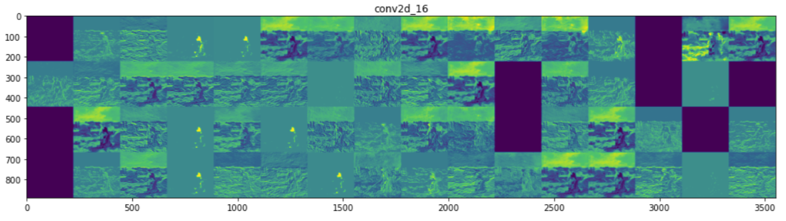
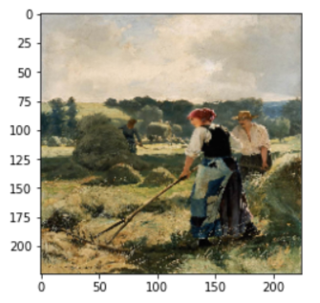
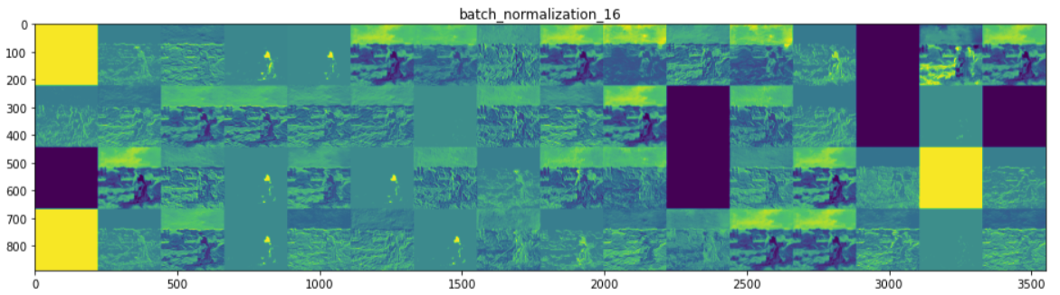
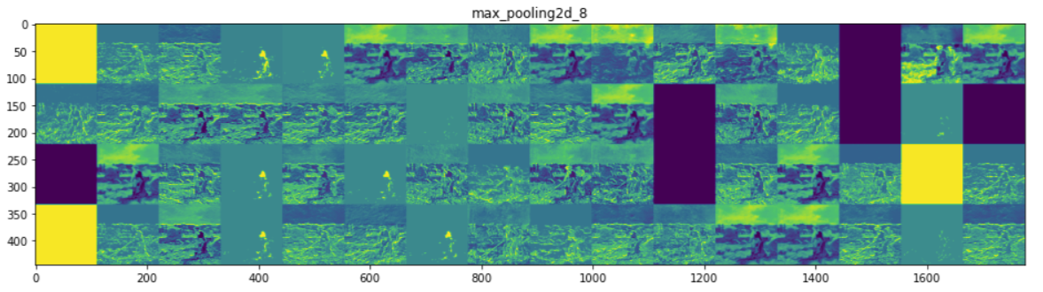

Slide 10
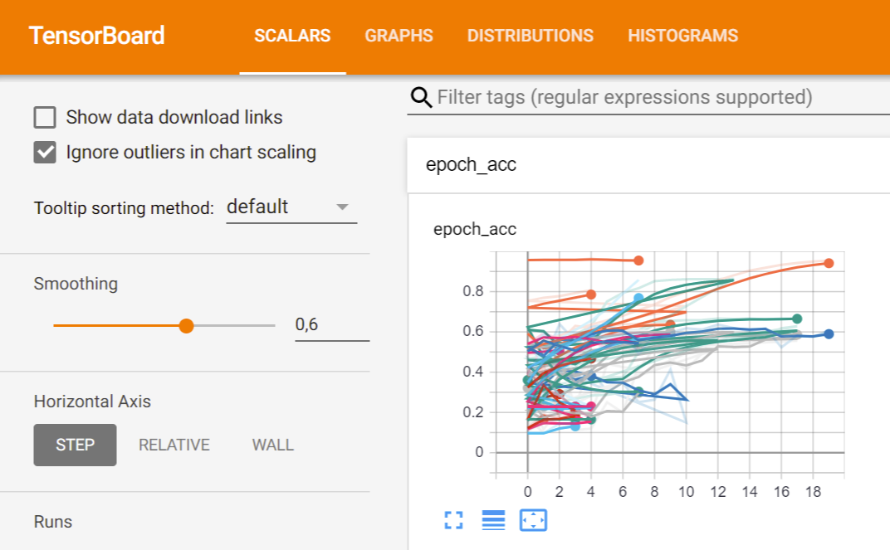

Slide 11
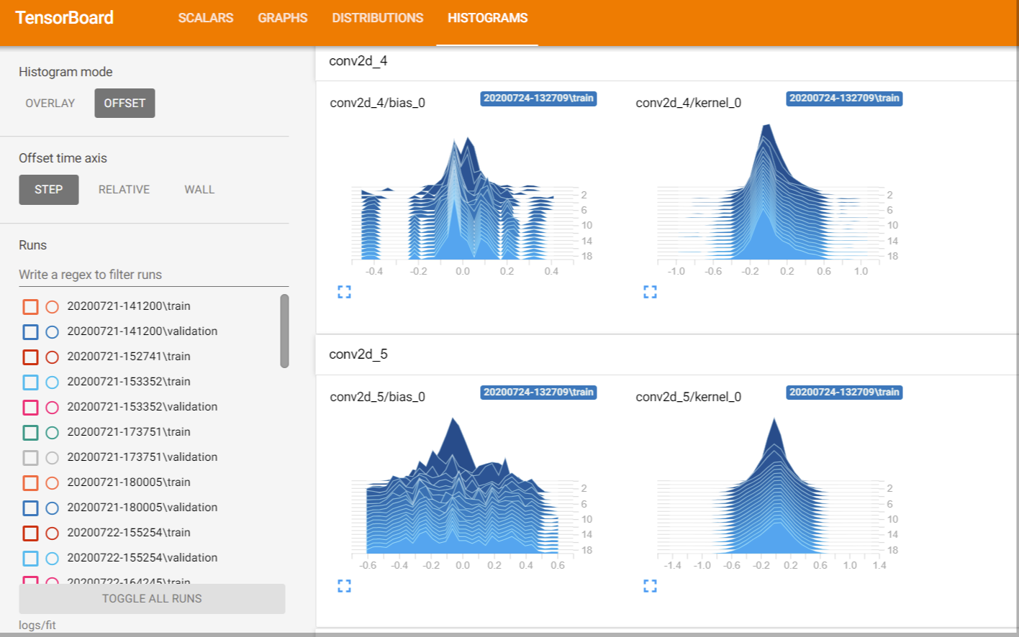

Slide 12
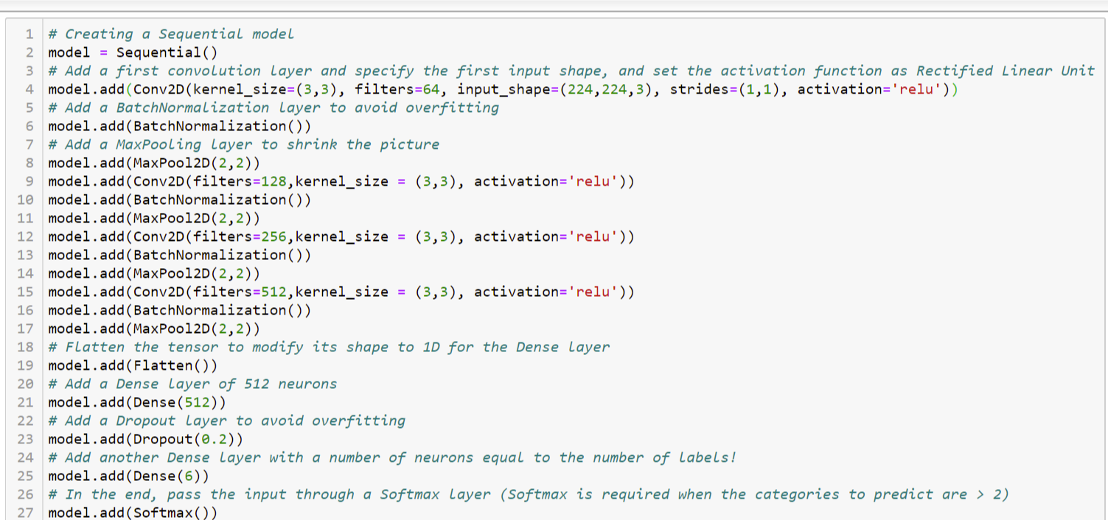

Slide 13
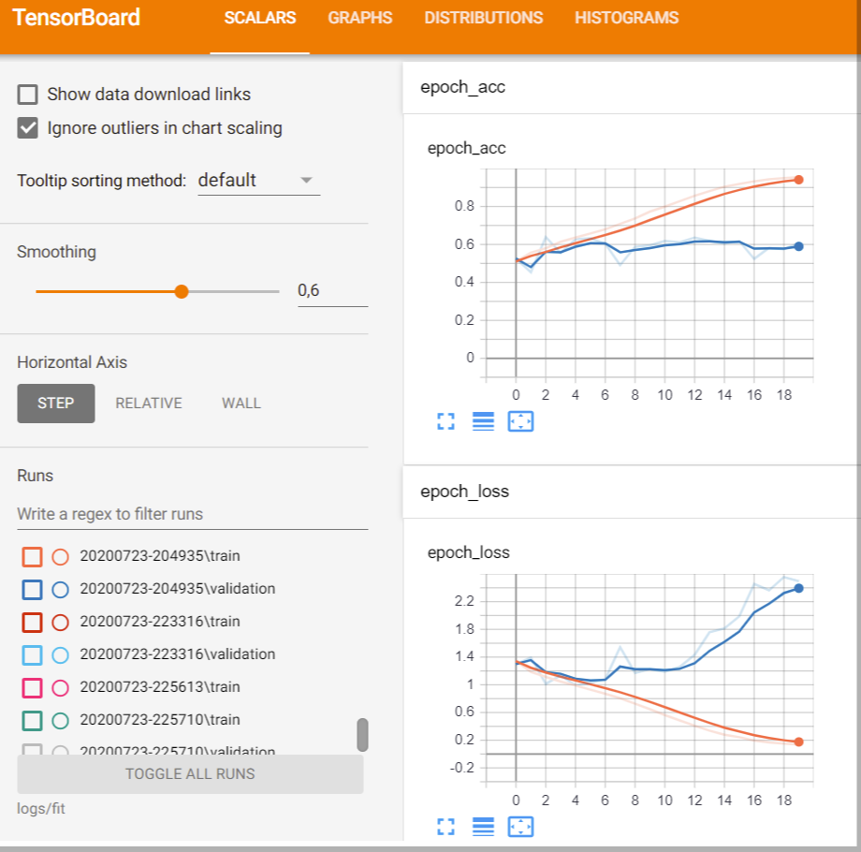

Slide 14
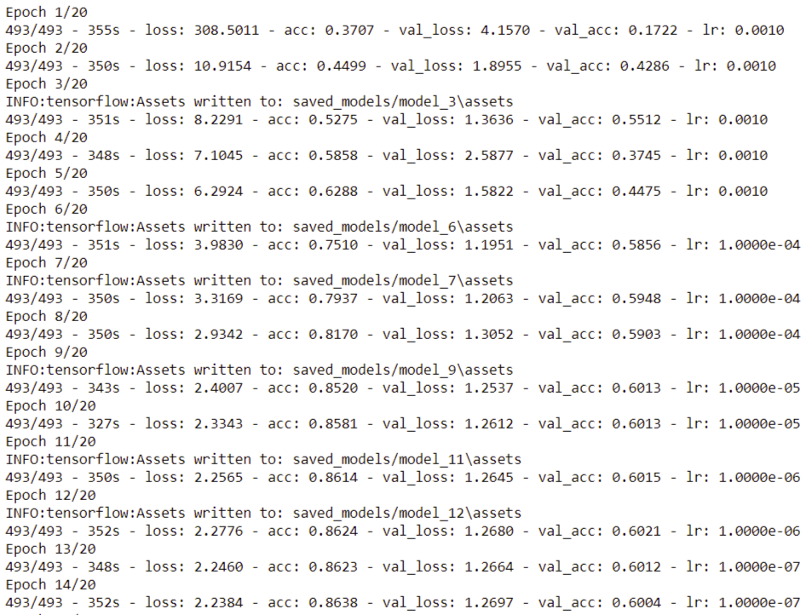

Slide 15

Obstacles
Running time: partially solved by setting Keras to use GPU instead of CPU (processing time per epoch decreased from 20 mins to 5)

Slide 16
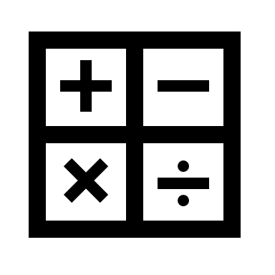
Obstacles
Computing capacity limitations: often I wanted to try different settings (like training the model with a 512x512 size pictures) but the calculations scaled up too much and my GPU ran out of memory.

Slide 17
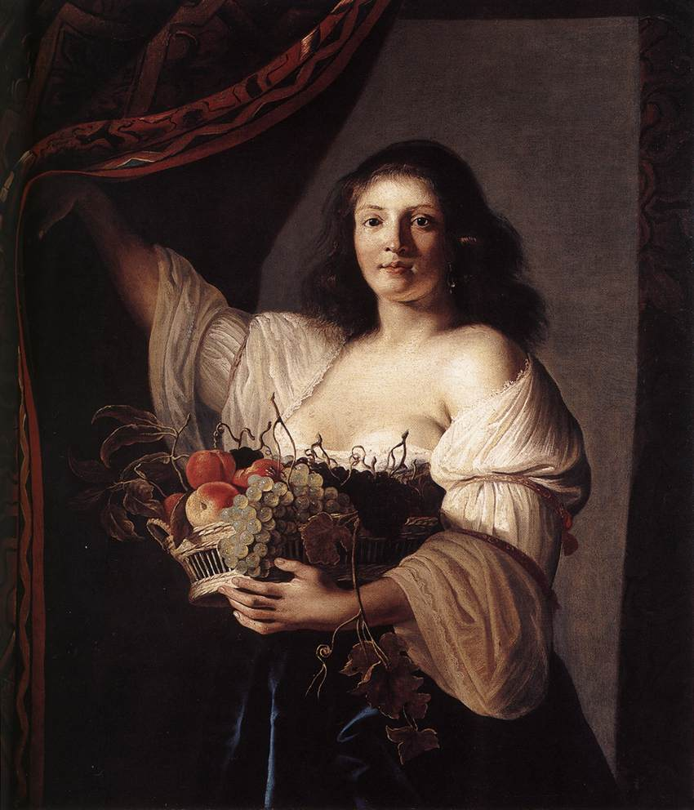
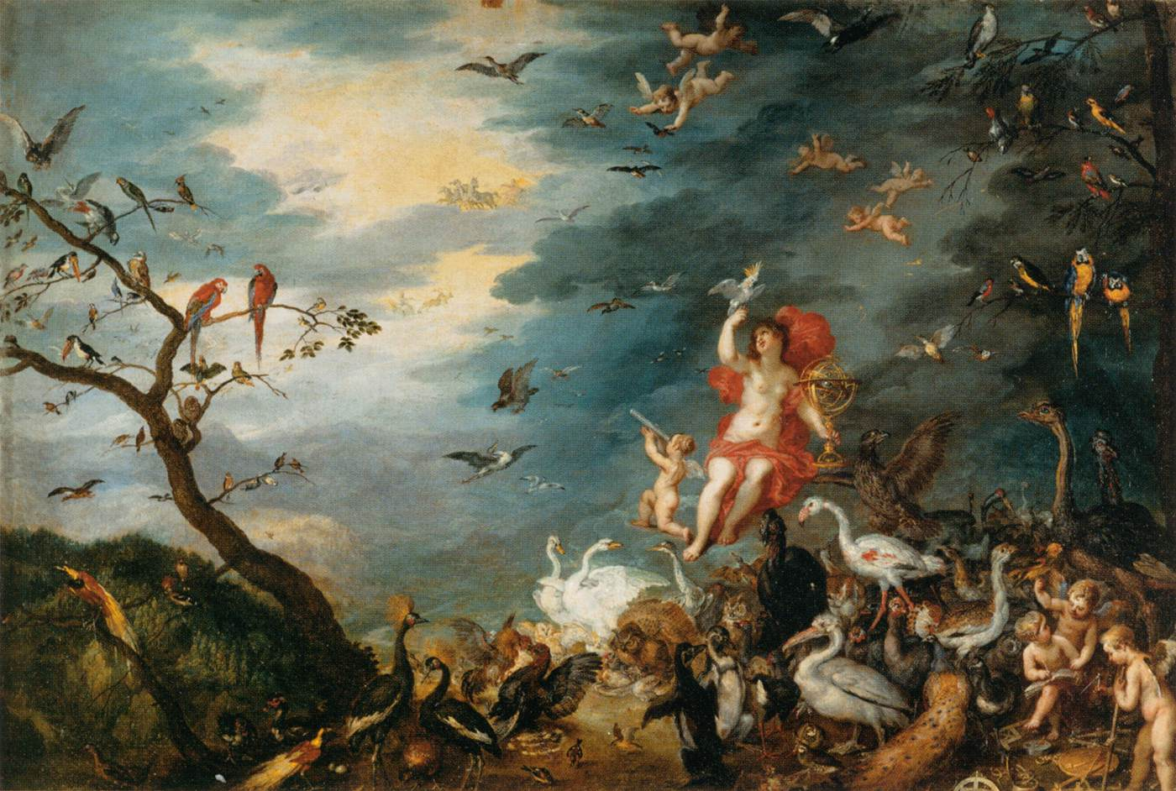
Obstacles
Double-label: by looking at some paintings, it’s difficult to say which type they belong to.
Portrait or still-life?
Mythological or religious?

Slide 18
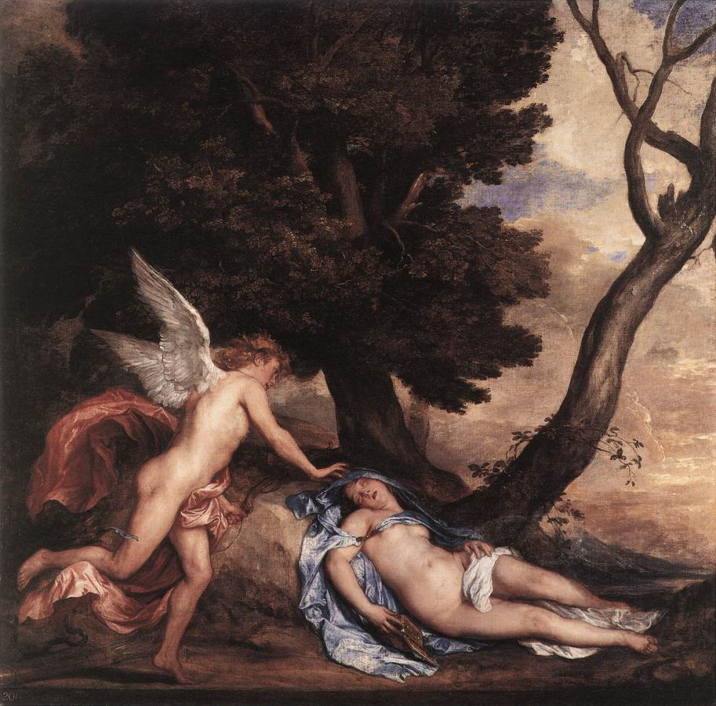
Obstacles
Context: how does the model possibly know this is not any angel but Cupid himself?
“Cupid and Psyche”, Sir Anthony van Dyck

Slide 19
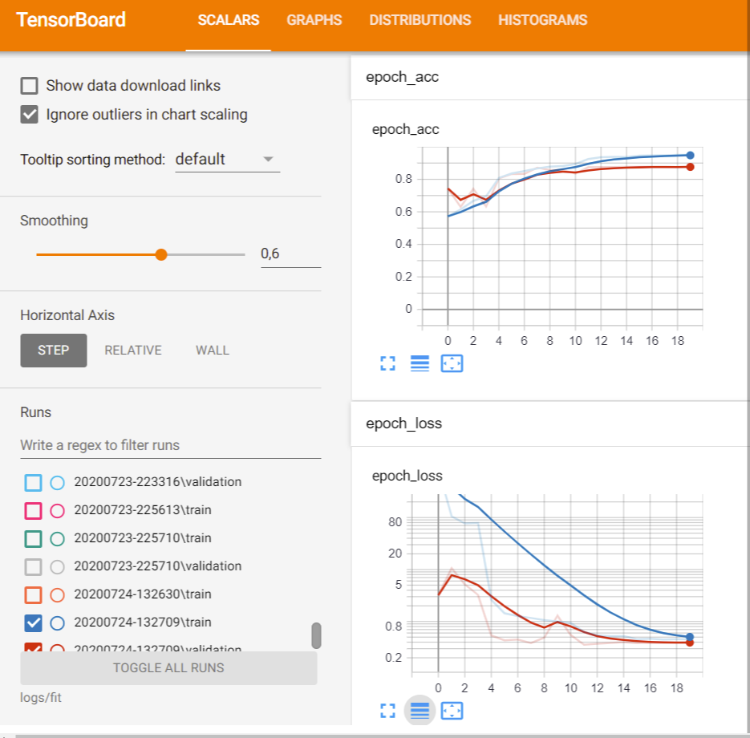

Slide 20
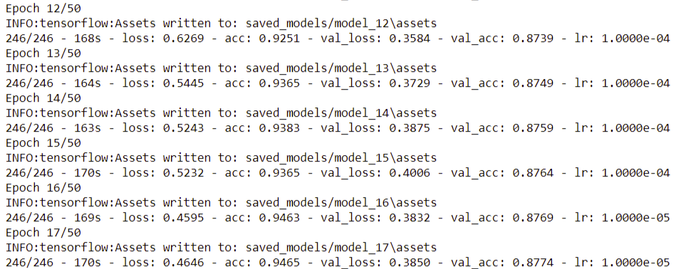

Slide 21
The End
Thanks for your time!

